Slide 1

Bugzilla ES Cluster
https://wiki.mozilla.org/BMO/ElasticSearch
  Kyle Lahnakoski
  Engineering Productivity

Slide 2
What’s the BZ ES Cluster?
A public web service
Historical snapshots of all public bugs for all time.
Only 10 min behind Bugzilla

Slide 3


What Data?
Bugzilla
BZ ES Cluster

Slide 4
What Data?
Bugs
Bugzilla
BZ ES Cluster

Slide 5
What Data?
Bugs
Bugs
Bugs
Bugs
Bugs
Bugs
Bugs
Bugs
Bugzilla
BZ ES Cluster
History of all bugs (75million records)

Slide 6
What Data?
Bugs
Bugs
Bugs
Bugs
Bugs
Bugs
Bugs
Bugs
Comments
Bugzilla
BZ ES Cluster
11million comment records

Slide 7
Why?
Make historical queries easy to phrase
Make complex queries fast
Ask for large amounts of data
Not meant for current bug state

Slide 8
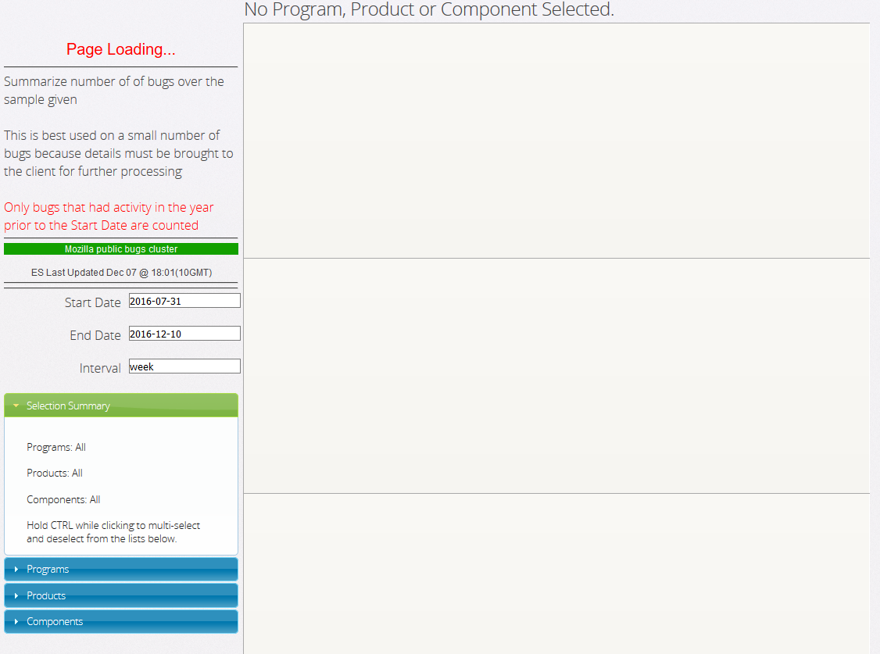
Dashboards
https://people-mozilla.org/~klahnakoski/modevmetrics/Bug-Counts.html

Slide 9
Dashboards
Start here
https://people-mozilla.org/~klahnakoski/modevmetrics/Bug-Counts.html

Slide 10
Dashboards
Notice, it’s blank
https://people-mozilla.org/~klahnakoski/modevmetrics/Bug-Counts.html

Slide 11
Dashboards
Pick a filter
https://people-mozilla.org/~klahnakoski/modevmetrics/Bug-Counts.html

Slide 12
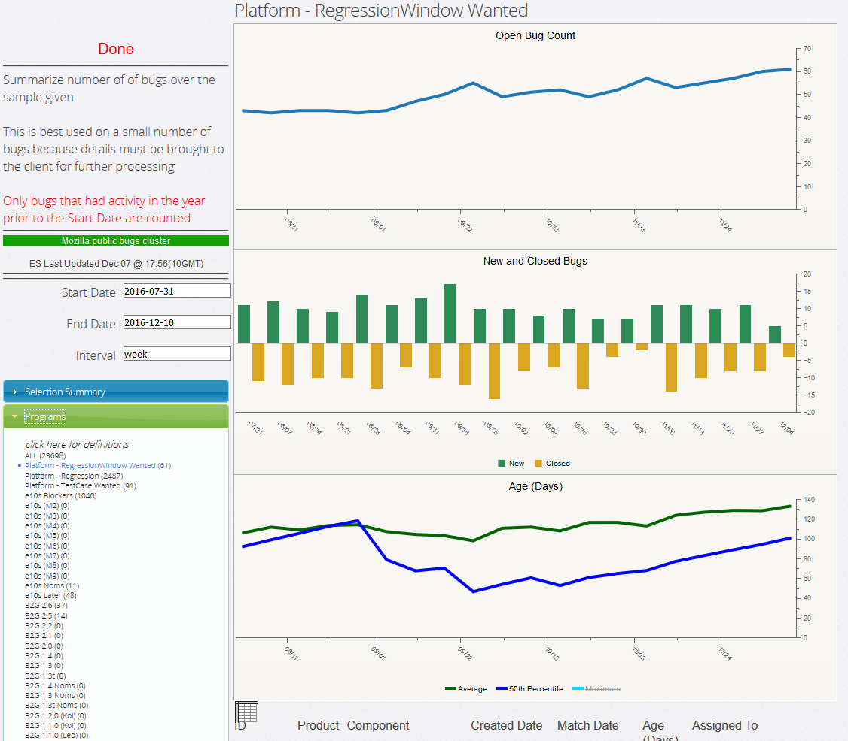
Dashboards
Lots of “programs” Pick one
https://people-mozilla.org/~klahnakoski/modevmetrics/Bug-Counts.html

Slide 13
Dashboards
https://people-mozilla.org/~klahnakoski/modevmetrics/Bug-Counts.html

Slide 14
Dashboards
Total active Bugs
https://people-mozilla.org/~klahnakoski/modevmetrics/Bug-Counts.html

Slide 15
Dashboards
Open and Close counts
https://people-mozilla.org/~klahnakoski/modevmetrics/Bug-Counts.html

Slide 16
Dashboards
Mean and Median Ages
https://people-mozilla.org/~klahnakoski/modevmetrics/Bug-Counts.html

Slide 17
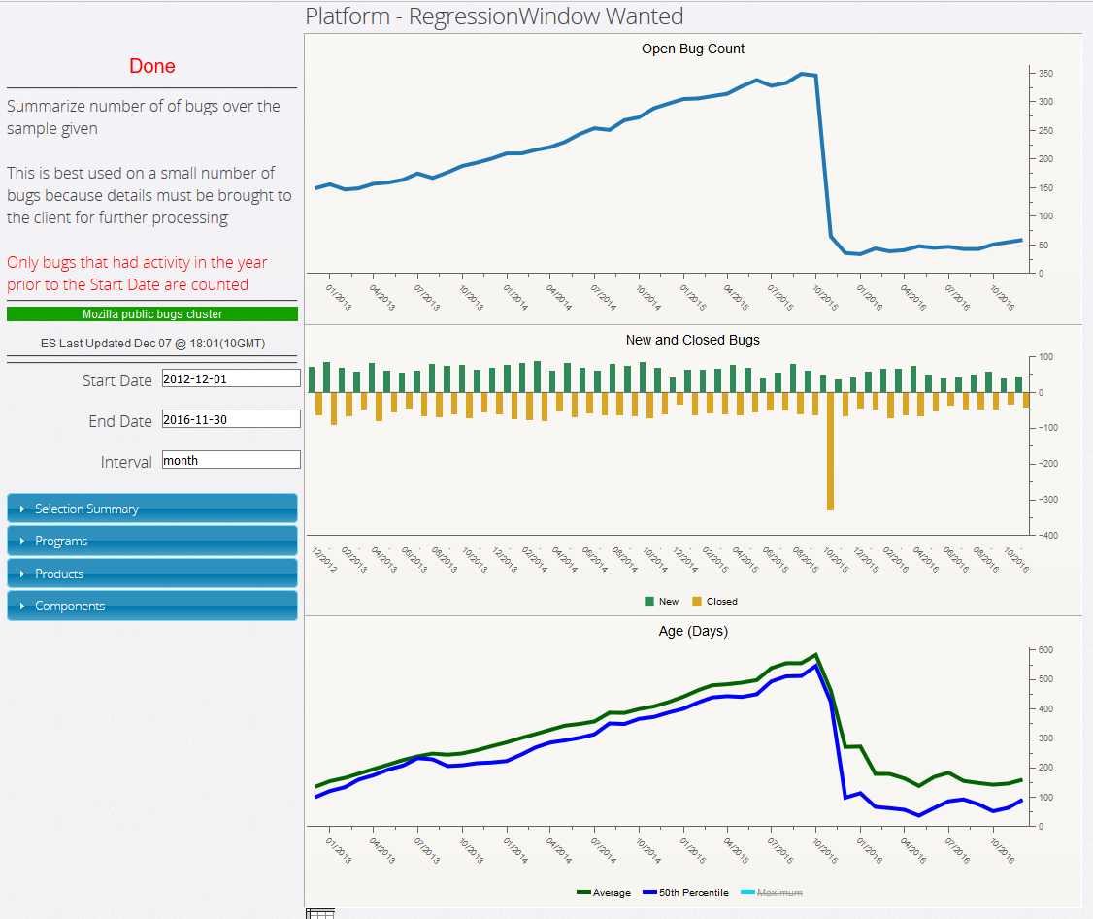
Dashboards
Choose date range
https://people-mozilla.org/~klahnakoski/modevmetrics/Bug-Counts.html

Slide 18

Dashboards
https://people-mozilla.org/~klahnakoski/bugzilla/

Slide 19
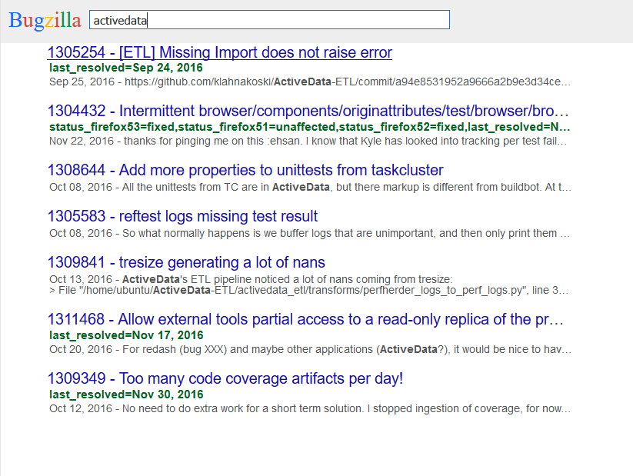
Dashboards
https://people-mozilla.org/~klahnakoski/bugzilla/

Slide 20
Ubiquitous Data!
Accessible data
Easy to query
Fast response time

Slide 21
Ubiquitous Data!
BZ ES Cluster

Slide 22
Ubiquitous Data!
BZ ES Cluster
ActiveData

Slide 23
Ubiquitous Data!
BZ ES Cluster
ActiveData

Slide 24

Ubiquitous Data!
BZ ES Cluster
ActiveData

Slide 25
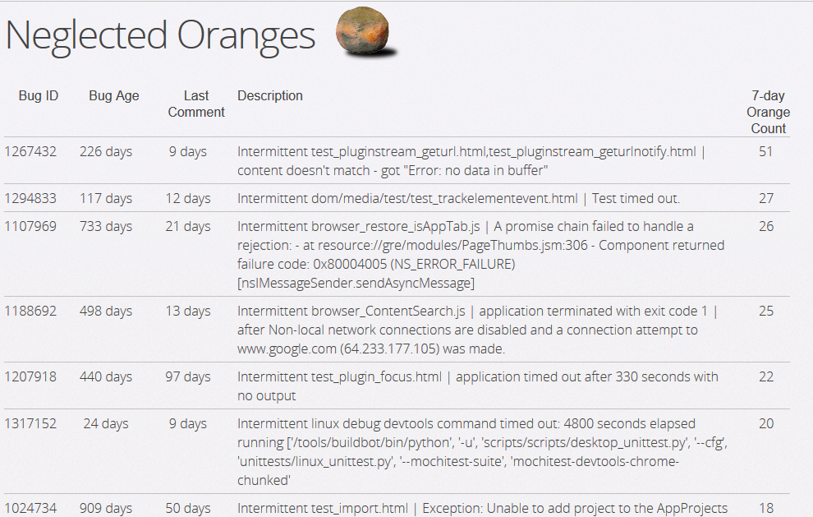
Ubiquitous Data!
https://people-mozilla.org/~klahnakoski/NeglectedOranges/index.html

Slide 26
Bugzilla ES Cluster
https://wiki.mozilla.org/BMO/ElasticSearch
  Kyle Lahnakoski
  Engineering Productivity

